Slide 1

Object Detection & Classification
Cynaptics Info Session2

Slide 2
Index
Basic Concept behind Object detection
Open CV
Yolo
DETR

Slide 3
What is Object Detection?
Computer vision technique that emulates human-like intelligence in recognizing and locating objects within images or videos. When humans view visual content, we effortlessly identify and pinpoint the presence of specific objects. Object detection algorithms, on the other hand, employ machine learning or deep learning methods to achieve a similar level of understanding.
Process of identifying and precisely locating objects of interest within an image or a frame of a video.
Involves recognizing the category or class to which these objects & outlining their positions with bounding boxes.
From enabling autonomous vehicles to navigate safely by recognizing other vehicles and pedestrians,enhancing surveillance systems' ability to detect suspicious activities, assisting in the medical field by identifying and localizing anomalies in radiological images.

Slide 4
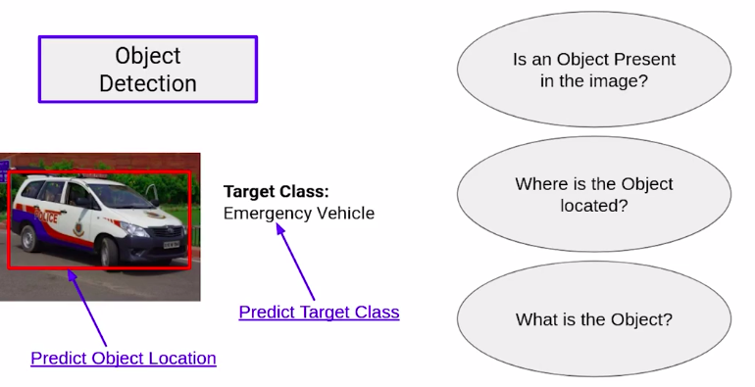
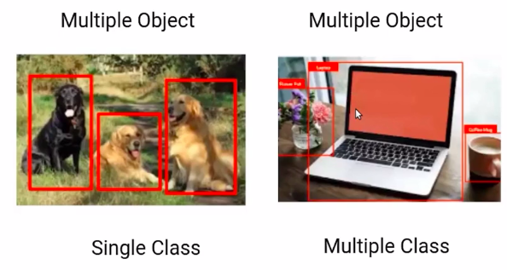

Slide 5
Where is Object Detection used?
Object detection is used in real-life applications across a wide range of domains, including:
Autonomous Vehicles: Object detection is crucial for self-driving cars to identify and track other vehicles, pedestrians, traffic signs, and obstacles on the road.
Surveillance and Security: It is used in surveillance systems to detect and track suspicious activities, intruders, or unattended bags in public spaces.
Retail: Object detection can be used for inventory management, helping retailers track the stock levels and identify when items need restocking.
Medical Imaging: In medical applications, object detection helps in identifying and localizing abnormalities in medical images, such as detecting tumors in radiology images.
Industrial Automation: It's used in manufacturing for quality control, identifying defects in products on assembly lines.
Agriculture: Object detection can be used to detect and count plants, fruits, and pests in agricultural fields.
Augmented Reality: Object detection is crucial in augmented reality applications for recognizing and tracking real-world objects to overlay digital information.

Slide 6
What is Computational Budget?
Computational Budget refers to the amount of computational resources, primarily in terms of FLOPs (Floating-Point Operations Per Second), memory, and processing time, that can be allocated to the model during both training and inference. It's essentially a measure of the hardware and processing capabilities available for running the model. The computational budget is crucial because it impacts the model's speed, accuracy, and practicality in real-world applications.

Slide 7
Models used for Object Detection
There are various models and approaches used for object detection, including:
Faster R-CNN: A two-stage model that combines a Region Proposal Network (RPN) with a Fast R-CNN network for object detection. It has been influential in achieving high accuracy.
YOLO (You Only Look Once): A one-stage object detection model that processes the entire image in a single forward pass, making it faster than some other models. YOLO versions like YOLOv8 and yoloNAS have gained popularity.
SSD (Single Shot MultiBox Detector): Another one-stage model that provides good trade-offs between speed and accuracy by using a set of default bounding boxes of different aspect ratios and scales.
RetinaNet: A one-stage model that introduces a novel focal loss to address the class imbalance problem in object detection. It offers a good balance between accuracy and speed.
EfficientDet: These models (EfficientDet-D0, D1, D2, etc.) are based on the EfficientNet architecture and provide efficient object detection solutions across different computational budgets.
Mask R-CNN: An extension of Faster R-CNN that not only detects objects but also provides pixel-level segmentation of object masks.
CenterNet: A single-stage model that focuses on detecting object centers and regressing the object's size and orientation, making it computationally efficient.

Slide 8
Models used for Object Detection
NAS (Neural Architecture Search): NAS-based object detection models use automated methods to search for optimal neural network architectures, resulting in highly efficient models.
Transformers: Transformers, originally developed for natural language processing, have been adapted for computer vision tasks, including object detection. Models like DETR (Data Efficient Transformer) and ViT (Vision Transformer) have shown promise in this domain.
VGG: While initially designed for image classification, VGG architectures can be adapted for object detection tasks, particularly in combination with region proposal networks (RPNs).
ResNet: Residual networks are popular for their deep architecture and ability to be used as a backbone in object detection models. They help extract feature representations from images.
Basic CNN Models: Traditional convolutional neural networks (CNNs) can serve as the foundation for object detection tasks when combined with region-based or anchor-based methods.

Slide 9
Region Based Methods
Region-based methods are also referred to as two-stage detection methods. They involve a two-step process to detect and classify objects:
Region Proposal: In the first step, these methods generate a set of region proposals or candidate bounding boxes that are likely to contain objects. These proposals are selected based on certain characteristics, such as the likelihood of containing an object or predefined anchors (bounding boxes of various sizes and aspect ratios).
Object Classification and Refinement: In the second step, the CNN is used to classify the objects within the proposed regions. The CNN is fine-tuned to recognize object categories and to refine the bounding box coordinates for precise object localization. This refinement is often done through techniques like bounding box regression.
A popular example of a region-based method is the Faster R-CNN, which combines region proposal networks (RPNs) and object detection networks to achieve high accuracy in object detection tasks.

Slide 10
Anchor Based Methods
Anchor-based methods, also known as one-stage detection methods, combine object localization and classification in a single step. Instead of relying on a separate region proposal step, anchor-based methods use predefined anchor boxes to predict object presence and location for each anchor in a grid over the image.
Anchor Boxes: Anchor boxes are pre-defined bounding boxes of different sizes and aspect ratios. These anchors are placed at various positions across the image in a grid. The network is trained to predict, for each anchor, whether an object is present and how the anchor's position and size should be adjusted to best fit the object if it is present.
Object Classification and Localization: In the same forward pass of the network, object classification and bounding box regression are performed for each anchor. This means the network simultaneously predicts object class scores and adjusts anchor coordinates to localize objects.
A well-known example of an anchor-based method is the Single Shot MultiBox Detector (SSD) and YOLO (You Only Look Once), which provide real-time object detection using this approach.

Slide 11
VGG
VGG stands for Visual Geometry Group; it is a standard deep Convolutional Neural Network (CNN) architecture with multiple layers. The “deep” refers to the number of layers with VGG-16 or VGG-19 consisting of 16 and 19 convolutional layers. The VGG architecture is the basis of ground-breaking object recognition models. Developed as a deep neural network, the VGGNet also surpasses baselines on many tasks and datasets beyond ImageNet. Moreover, it is now still one of the most popular image recognition architectures.

Slide 12
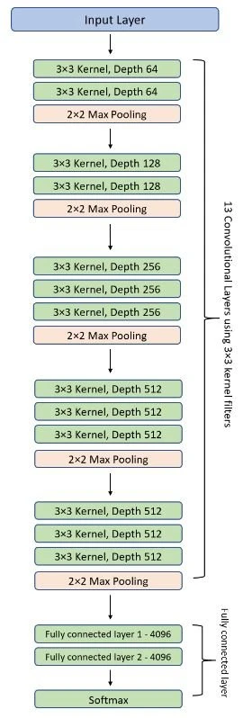


Slide 13
ResNet50 (Residual Networks)
One of the problems ResNets solve is the famous known vanishing gradient. This is because when the network is too deep, the gradients from where the loss function is calculated easily shrink to zero after several applications of the chain rule. This result on the weights never updating its values and therefore, no learning is being performed.
With ResNets, the gradients can flow directly through the skip connections backwards from later layers to initial filters.

Slide 14
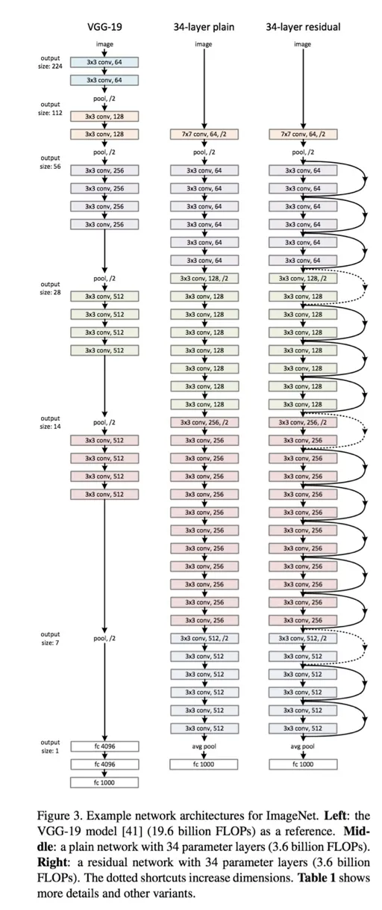

Slide 15
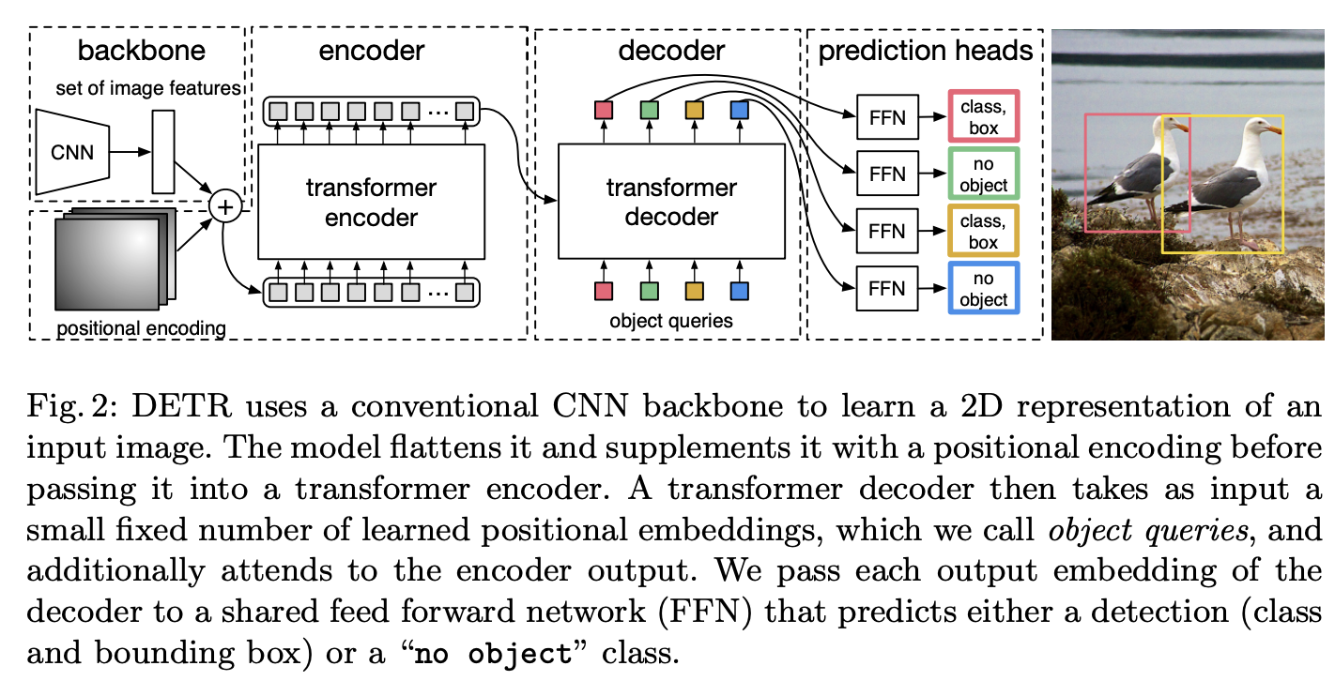
DETR
Detr, or Detection Transformer, is a set-based object detector using a Transformer on top of a convolutional backbone. It uses a conventional CNN backbone to learn a 2D representation of an input image. The model flattens it and supplements it with a positional encoding before passing it into a transformer encoder.

Slide 16
Why use DETR?
Nowadays, transformers have become the dominant model in natural language processing owning to their ability to learn complex dependencies between input sequences via self-attention. We also observe that the recently introduced vision transformers achieve competitive results on benchmark classification tasks by treating an image as a sequence of patches.For convolutional networks, the locality of the convolution operation limits its capacity for capturing global context information. In contrast, transformers are capable of globally focusing on dependencies between image feature patches and retain sufficient spatial information for object detection via multi-head self-attention.

Slide 17
Local Features
Local features refer to information that pertains to specific regions or parts of an image. These features are concerned with what is happening in smaller, localized areas.
Local features might include details like edges, textures, color gradients, and patterns found in a specific region of the image. These features are extracted through techniques like convolutional operations in Convolutional Neural Networks (CNNs).
Local features are essential for recognizing the fine-grained details of objects. For example, they help in identifying the edges and corners of an object, which can be crucial for accurately localizing and classifying objects.

Slide 18
Global Features
Global features, on the other hand, capture information about the image as a whole. They consider the relationships and context between different regions of the image and provide a more holistic view.
In object detection, global features can include information about the overall scene, the spatial arrangement of objects, and the context in which objects appear. They can help in understanding the relative positions and sizes of objects.
Transformers, which were originally designed for natural language processing, are capable of capturing global features effectively. They allow the model to consider long-range dependencies and relationships between objects in the image.

Slide 19
New Approach
The study in the literature has indicated that vision transformers are much more highly robust to severe occlusions, perturbations and domain shifts, compared to CNNs. Therefore, an intuitive way for enhancing the detection performance is to embed the transformer layer into the purely convolutional backbone to bring more context information and learn more distinguishable feature representations.

Slide 20
Basic idea behind Object Detection
The basic idea: to recognize and locate objects of interest within images or video frames. This involves determining what objects are present in the visual data and providing their precise positions, often by drawing bounding boxes around them.
several key steps:
Feature Extraction: Initially, the input image is processed to extract relevant features that help in distinguishing objects. Convolutional Neural Networks (CNNs) are commonly used for this purpose. These networks analyze the image at different scales, learning to recognize edges, textures, shapes, and more complex visual patterns.
Region Proposal: In many object detection models, a region proposal mechanism is employed to identify potential regions where objects might be located. These regions, often referred to as region proposals, are generated using techniques like Selective Search, EdgeBoxes, or R-CNN (Region-based Convolutional Neural Networks).
Classification: Each of the proposed regions is passed through a classification network. This network is trained to determine what object or class is present in the region. Typically, it assigns a probability score to each class, indicating the likelihood of an object belonging to a specific category.
Bounding Box Regression: Alongside classification, the model performs bounding box regression. This involves adjusting the dimensions and position of the bounding box around the object to better fit the object's actual location and size.
Non-Maximum Suppression (NMS): To ensure that multiple bounding boxes are not assigned to the same object, a post-processing step called non-maximum suppression is applied. It removes redundant or overlapping bounding boxes and retains the one with the highest confidence score.
Output: The final output consists of the classes of detected objects, their corresponding bounding boxes, and the confidence scores associated with each detection. This information can be used for various downstream applications, such as tracking objects or generating alerts in surveillance systems.

Slide 21
CNN
In the field of deep learning, convolutional neural network (CNN) is among the class of deep neural networks, which was being mostly deployed in the field of analyzing/image recognition.
Convolutional Neural uses a very special kind of method which is being known as Convolution.
The mathematical definition of convolution is a mathematical operation being applied on the two functions that give output in a form of a third function that shows how the shape of one function is being influenced, modified by the other function.

Slide 22
The Convolutional neural networks(CNN) consists of various layers of artificial neurons. Artificial neurons, similar to that neuron cells that are being used by the human brain for passing various sensory input signals and other responses, are mathematical functions that are being used for calculating the sum of various inputs and giving output in the form of an activation value.
The behaviour of each CNN neuron is being defined by the value of its weights. When being fed with the values (of the pixel), the artificial neurons of a CNN recognizes various visual features and specifications.

Slide 23
When we give an input image into a CNN, each of its inner layers generates various activation maps. Activation maps point out the relevant features of the given input image. Each of the CNN neurons generally takes input in the form of a group/patch of the pixel, multiplies their values(colours) by the value of its weights, adds them up, and input them through the respective activation function.
The first (or maybe the bottom) layer of the CNN usually recognizes the various features of the input image such as edges horizontally, vertically, and diagonally.
The output of the first layer is being fed as an input of the next layer, which in turn will extract other complex features of the input image like corners and combinations of edges.
The deeper one moves into the convolutional neural network, the more the layers start detecting various higher-level features such as objects, faces, etc

Slide 24
Basic Architecture
A CNN architecture consists of two key components:
• A convolution tool that separates and identifies the distinct features of an image for analysis in a process known as Feature Extraction.This is done by the base.
• A fully connected layer that takes the output of the convolution process and predicts the image’s class based on the features retrieved earlier.This is done by the Head
The CNN is made up of three types of layers: convolutional layers, pooling layers, and fully-connected (FC) layers.

Slide 25

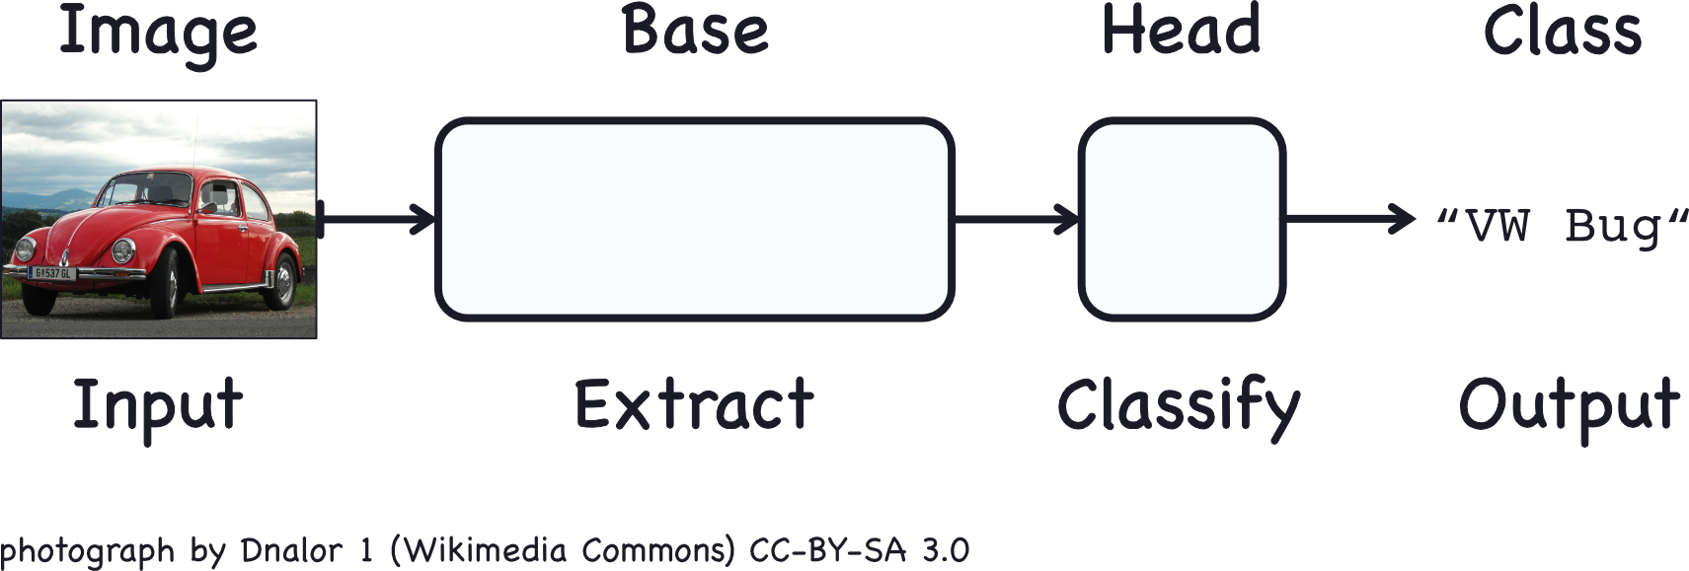

Slide 26
Different Layers
Convolution Layers
This is the very first layer in the CNN that is responsible for the extraction of the different features from the input images. The convolution mathematical operation is done between the input image and a filter of a specific size MxM in this layer.
The Fully Connected
The Fully Connected (FC) layer comprises the weights and biases together with the neurons and is used to connect the neurons between two separate layers. The last several layers of a CNN Architecture are usually positioned before the output layer.
Pooling layer
The Pooling layer is responsible for the reduction of the size(spatial) of the Convolved Feature. This decrease in the computing power is being required to process the data by a significant reduction in the dimensions.
There are two types of pooling
1 average pooling
2 max pooling.

Slide 27


Slide 28
Dropout
To avoid overfitting (when a model performs well on training data but not on new data), a dropout layer is utilised, in which a few neurons are removed from the neural network during the training phase, resulting in a smaller model.
Activation Functions
They’re utilised to learn and approximate any form of network variable-to-variable association that’s both continuous and complex.
It gives the network non-linearity. The ReLU, Softmax, and tanH are some of the most often utilised activation functions.

Slide 29
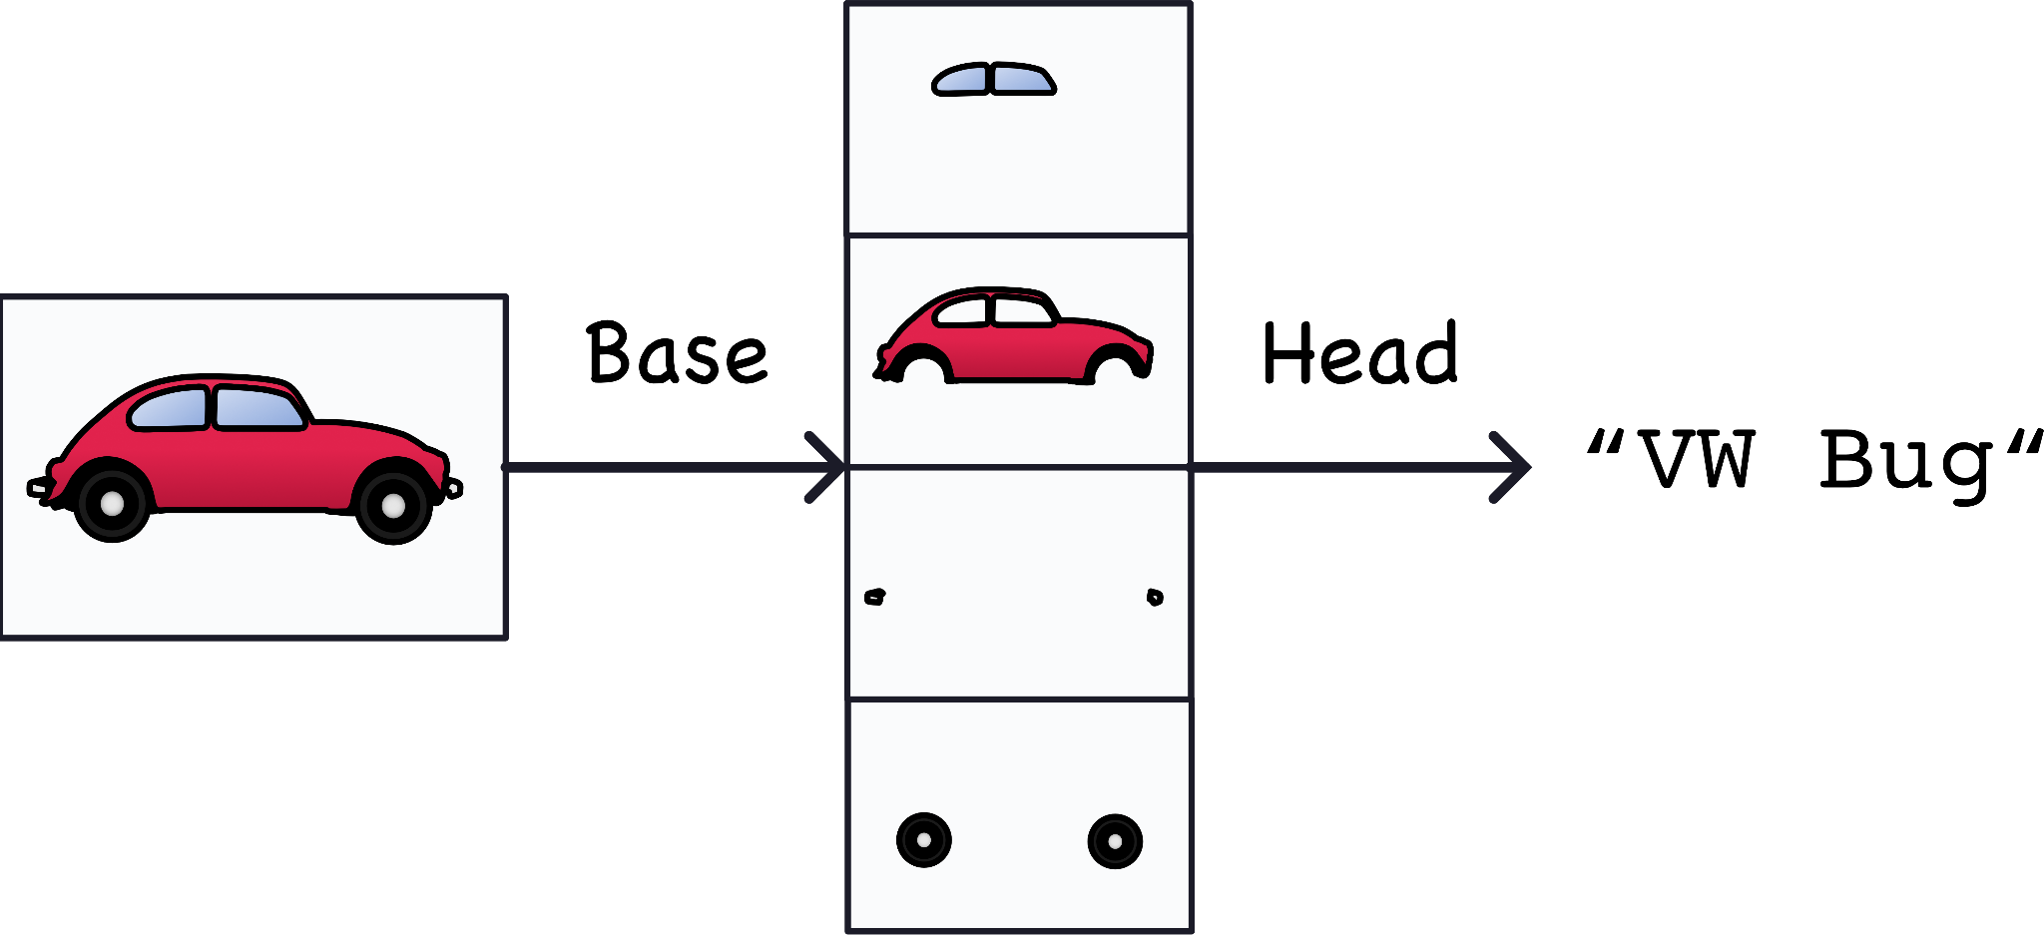
Feature Extraction

Slide 30
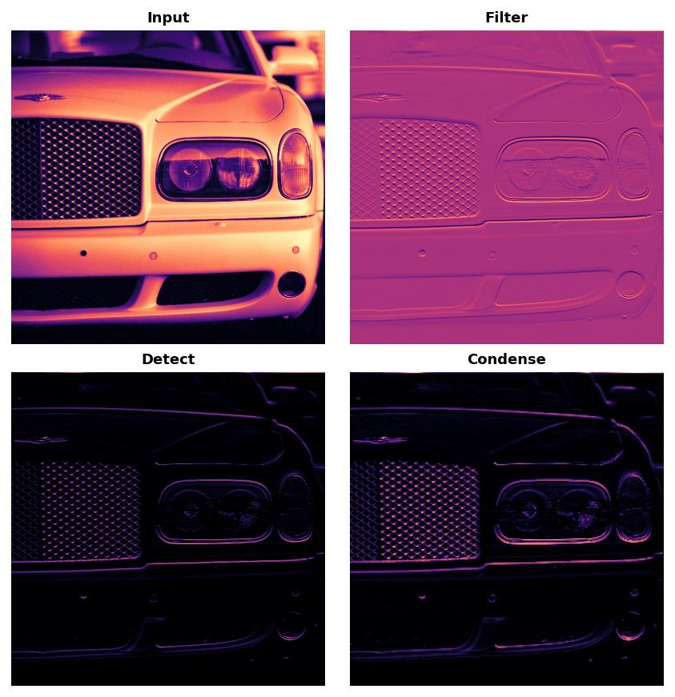
Feature Extraction
The feature extraction performed by the base consists of three basic operations:
Filter an image for a particular feature (convolution)
Detect that feature within the filtered image (ReLU)
Condense the image to enhance the features (maximum pooling)

Slide 31

An RGB image is nothing but a matrix of pixel values having three planes whereas a grayscale image is the same but it has a single plane. Take a look at this image to understand more.

Slide 32
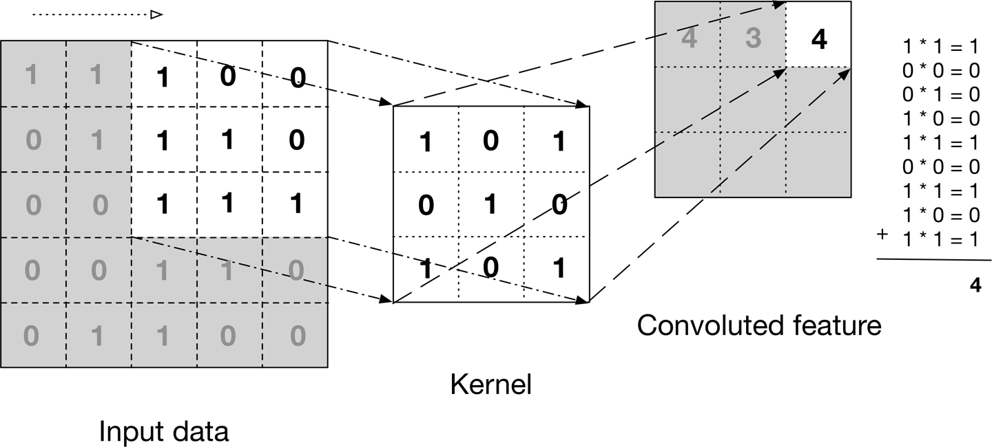
For simplicity, let’s stick with grayscale images as we try to understand how CNNs work.

Slide 33


Slide 34


Slide 35
Overview
Convolutional neural networks are composed of multiple layers of artificial neurons. Artificial neurons, a rough imitation of their biological counterparts, are mathematical functions that calculate the weighted sum of multiple inputs and outputs an activation value. When you input an image in a ConvNet, each layer generates several activation functions that are passed on to the next layer.
The first layer usually extracts basic features such as horizontal or diagonal edges. This output is passed on to the next layer which detects more complex features such as corners or combinational edges. As we move deeper into the network it can identify even more complex features such as objects, faces, etc.
Based on the activation map of the final convolution layer, the classification layer outputs a set of confidence scores (values between 0 and 1) that specify how likely the image is to belong to a “class.” For instance, if you have a ConvNet that detects cats, dogs, and horses, the output of the final layer is the possibility that the input image contains any of those animals.

Slide 36
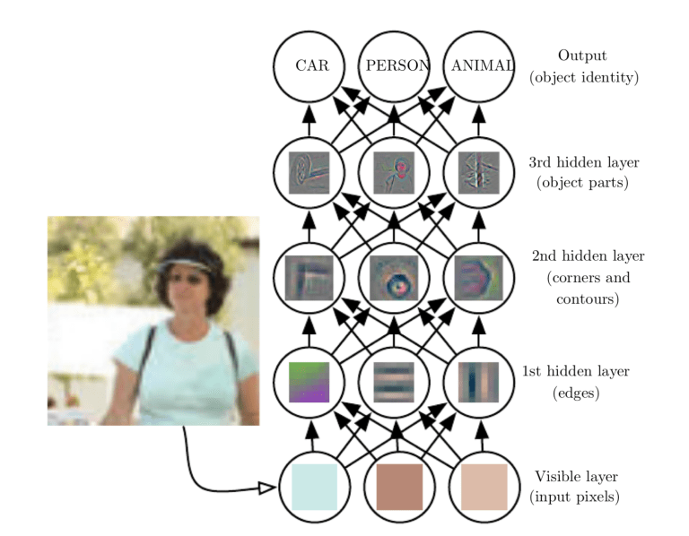

Slide 37

Pooling Layer
Similar to the Convolutional Layer, the Pooling layer is responsible for reducing the spatial size of the Convolved Feature. This is to decrease the computational power required to process the data by reducing the dimensions. There are two types of pooling average pooling and max pooling. I’ve only had experience with Max Pooling so far I haven’t faced any difficulties.

Slide 38


Slide 39
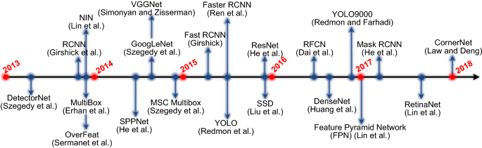
Object Detection Family Tree

Slide 40
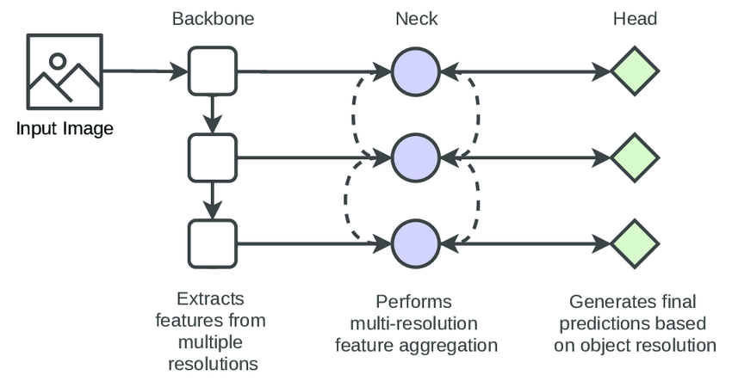
Backbones , Head , Neck vs Models

Slide 41
A detection model contains a backbone, neck, head module. The backbone module exploits the essential features of different resolutions, and the neck module fuses the features of different resolutions. Finally, multiple head modules perform the detection of objects in different resolutions.

Slide 42
Backbone
The Backbone Network are commonly seen in the Object detection model architectures. Backbone is responsible for extracting and encoding features from the input data. It acts as the core feature extractor, capturing low-level and high-level features from the input data.
State-of-the-art (SOTA) models, such as VGG and ResNet, are commonly employed as backbone architectures to extract essential features from an input image. These extracted features serve as the foundation for subsequent processing, including the utilization of Fully Convolutional Neural Networks (FCNNs), to make predictions or classifications.

Slide 43
Neck
Neck is responsible for further transforming and refining the features extracted by the backbone model. Its goal is to improve the backbone’s extracted features, and give more informative feature representations.
The backbone is responsible for the initial feature extraction from the input data, while the neck enhances and merge those features to improve the model’s performance.

Slide 44
Head
The head is made up of task-specific layers that are designed to produce the final prediction or inference based on the information extracted by the Backbone and Neck.

Slide 45
Loss Functions in Object Detection
Loss functions are the heart of deep learning algorithms (in case you are wondering, backprop the soul). Loss functions tells the model how good the model is at particular task. Depending on the problem to solve, almost all model aim to minimize the loss.
If we make any changes to our model in hope(trying different hyperparameters) of creating better model, loss function will tell if we’re getting better model than previous model trained. If predictions of the model are totally off, loss function will output a higher number. If they’re pretty good, it’ll output a lower number.
Designing/utilizing a appropriate loss functions to solve our particular task is one of the critical steps in deep learning, if we choose a poor error(loss) function and obtain unsatisfactory results, the fault is ours for badly specifying the goal of the search.

Slide 46
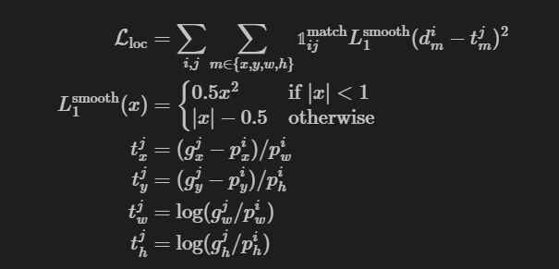
Classification Loss
As the name suggests, this loss will help with any task which requires classification. We are given k categories and our job is to make sure our model is good job in classifying x number of examples in k categories
Localisation Loss
The localization loss is a smooth L1 loss between the predicted bounding box correction and the true values. The coordinate correction transformation is same as what R-CNN does in bounding box regression.

Slide 47
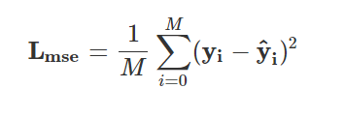
Mean Squared Error(MSE)
These error functions are easy to define. As the name suggests, we are taking square of error and then mean of these sqaured error functions. It’s only concerned with the average magnitude of error irrespective of their directionHowever, due to squaring, predictions which are far away from actual values are penalized heavily in comparison to less deviated predictions. This error is also known as L1 loss. Suppose, y^ is our predicted output by the model and y is target(actual or expected) value. For M training example, mse loss can be formulated as,
Multi-class Classification
As name suggests, if there are more than two classes that we want our images to be classified into, then we use multi-class classification error function. It is used as a loss function in neural networks which have softmax activations in the output layer. The model outputs the probability the example belonging to each class.

Slide 48
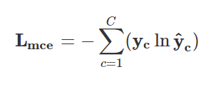
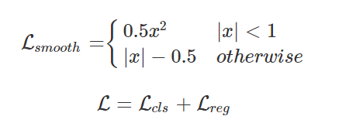
Smooth L1 Loss
In general for all object detection algorithms, there are two main objective functions to minimize. The first one is classfication loss(Lcls) which we have seen multiple times, but this classification loss is multi-class classification loss which translates to log-loss we defined above. The second loss function is regression loss(Lreg) over predicted 4 values of bounding boxes which as we have defined above as combination of L1 loss and L2 loss also known as smooth L1 loss. Smooth L1-loss combines the advantages of L1-loss (steady gradients for large values of x) and L2-loss (less oscillations during updates when x is small).

Slide 49
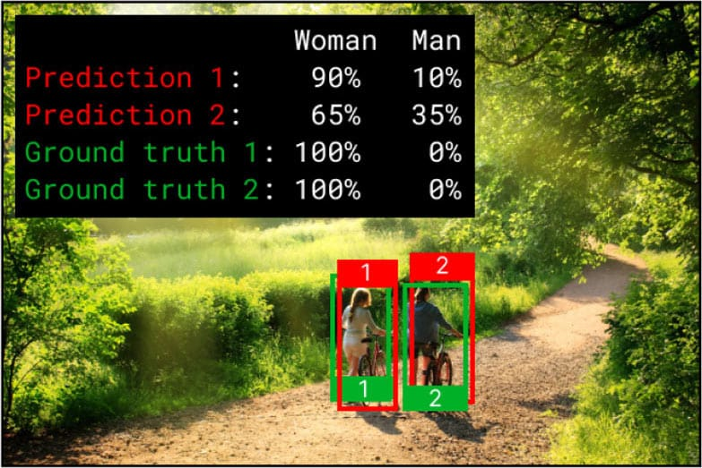
Cross Entropy Loss

Slide 50
the object detector will try to predict a probability for each class at a predicted bounding box location. This probability can also be thought of as the model’s confidence. The higher the probability the more confident the model is, that a given localized object belongs to some class. Let’s consider the predictions and ground truths in figure
The object detector has calculated a probability for how confident it is in each of the classes, woman and man, for each predicted bounding box. The model is 90% confident that prediction 1 is a woman and 65% confident that prediction 2 is a woman.
The predictions are not bad, but especially prediction 2, has a low prediction confidence of only 65%. From the annotated ground truths we know there is, with 100% certainty, a woman at the location.

Slide 51
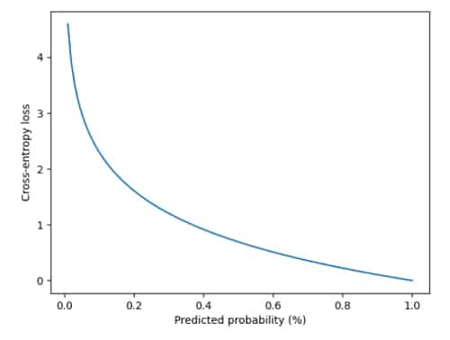
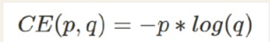
One way of calculating how well the object detector predicted the class would be to calculate the absolute difference between the predicted probability and the actual (e.g. loss of 100%-90%=10 for prediction 1 and 100%-65%=35 for prediction 2). Another way, is through cross-entropy. Cross-entropy gives a smoother loss, which penalizes big differences a lot and small difference a little. Cross-entropy loss between a ground truth probability, p, and a predicted probability, q, is given by the following equation

Slide 52
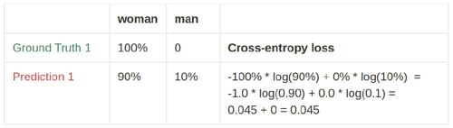
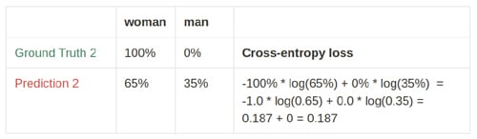

Slide 53
Focal Loss
Focal Loss is a specialized loss function used in machine learning, particularly in the context of object detection. It is designed to address the problem of class imbalance, where certain classes are rare and may not be adequately learned by a model. Focal Loss was introduced by Lin et al. in the paper "Focal Loss for Dense Object Detection."
The key idea behind Focal Loss is to down-weight the easy-to-classify examples (common classes) during training, allowing the model to focus more on the challenging examples (rare classes or difficult cases). This helps improve the model's ability to handle both common and rare classes effectively.

Slide 54
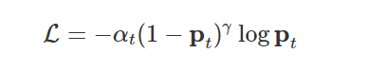
Alpha (α): This parameter assigns different weights to each class. It emphasizes the importance of rare classes by giving them a higher weight (α < 0.5) and, conversely, de-emphasizing common classes (α > 0.5).
Gamma (γ): The gamma parameter modulates the rate at which the loss decreases for well-classified examples. A higher gamma places more focus on hard examples, preventing the model from prematurely converging to suboptimal solutions.

Slide 55
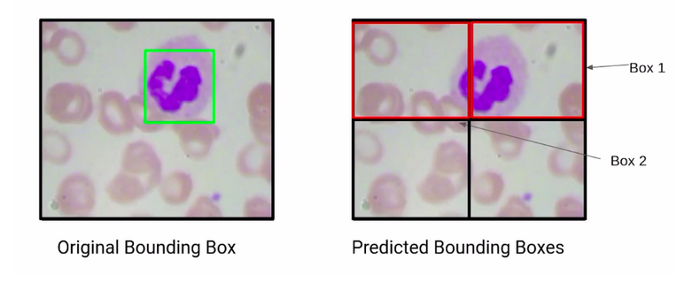
Metrics used for Object Detection

Slide 56
IoU (Intersection over Union)
Here we have two bounding boxes, box1 and box2. Now if we have to compare which of these two boxes is more accurate, the obvious answer is box1.
Why? Because it has a major region of the WBC and has correctly detected the WBC. But how can we find this out mathematically?
So, compare the actual, and the predicted bounding boxes. if we are able to find out the overlap of the actual, and the predicted bounding box, we will be able to make a decision as to which bounding box is a better prediction.
So the bounding box that has a higher overlap with the actual bounding box is a better prediction. Now, this overlap is called the area of intersection for this first box, which is box1. We can say that the area of intersection is about 70% of the actual bounding box.
Whereas, if you consider box2, the area of intersection of the second bounding box, and the actual bounding box is about 20 %.

Slide 57
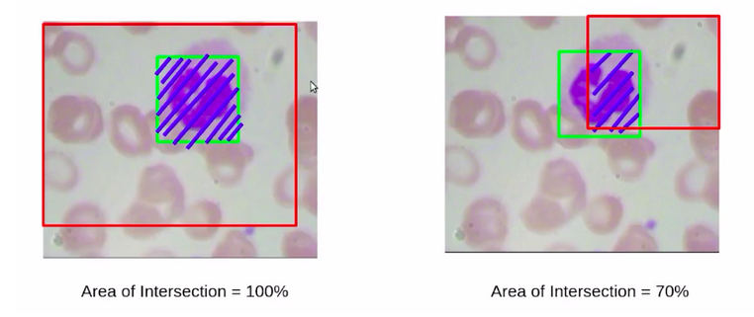
Here, the intersection of the left bounding box is certainly 100% whereas, in the second image, the intersection of this predicted bounding box, or this particular patch is just 70%. So at this stage, would you say that the bounding box on the left is a better prediction? obviously not. The bounding box on the right is more accurate.
So, to deal with such scenarios, we also consider the area of union, which is the patch area, as well as the actual bounding box area.

Slide 58
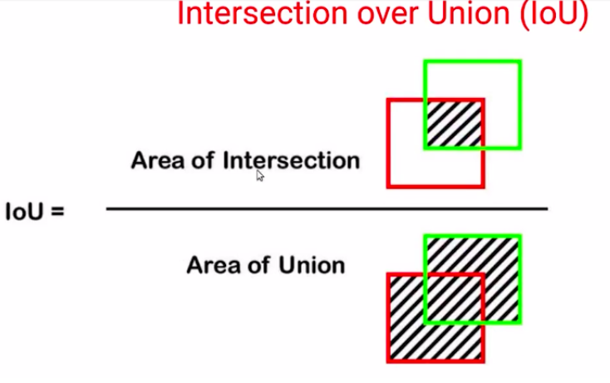

Slide 59
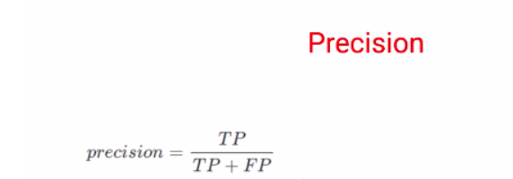
mAP (Mean Average Precision)
What is Precision?
TP : True Positives
FP : False Positives

Slide 60
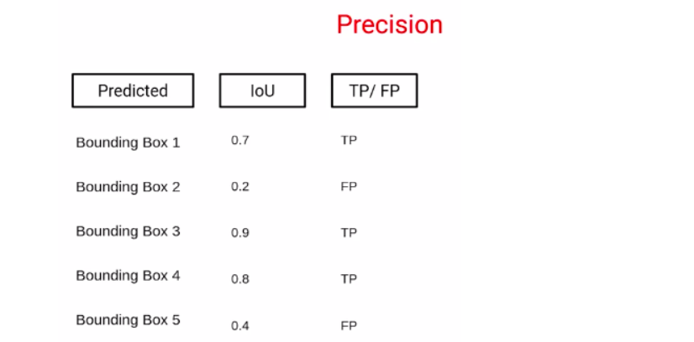
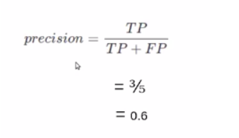
Threshold = 0.5

Slide 61
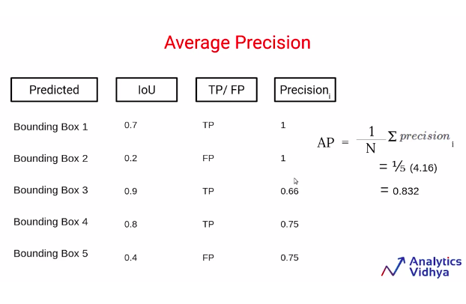
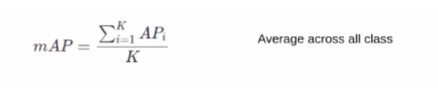
The Mean Average Precision (mAP) serves as a vital metric of accuracy, quantifying the model's performance by evaluating the proportion of accurately predicted positive detections among the total positive detections.

Slide 62
Recall
It is an evaluation metric for the classification problem that quantifies the ability of a model to identify all the relevant instances from the dataset correctly. It is also known as Sensitivity or True Positive Rate (TPR).
In simple terms, it answers the question: “Out of all the actual positives, how many were correctly predicted by the model?“.
Mathematically, it is defined as the Number of True Positives divided By the Number of True Positives and False Negative.

Slide 63
F1 Score
The F1 score combines precision and recall using their harmonic mean, and maximizing the F1 score implies simultaneously maximizing both precision and recall. Thus, the F1 score has become the choice of researchers for evaluating their models in conjunction with accuracy.

Slide 64
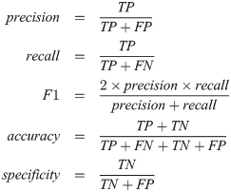

Slide 65
Tutorial-1
Visualise Models
Classify handwritten numbers
Collab - want to try some basic image classification tasks? Here’s an example you can learn from!
Visualise - want to visualise how models actually work? Here are some helpful tools!

Slide 66

OpenCV: The Visionary Library for Computer Vision and Machine Learning
OpenCV is a free and open-source cross-platform library for computer vision and machine learning. It offers a wide range of features, include:
Image processing
Feature detection and description
Object detection and tracking
OpenCV is written in C++ and Python, and it can be used to develop applications for a variety of platforms, including Windows, Linux, macOS, Android, and iOS.
OpenCV is used in a wide variety of applications, that include image processing :
Robotics: OpenCV is used in robotics for tasks such as navigation, object detection, and obstacle avoidance.
Augmented reality: OpenCV is used in augmented reality applications for tasks such as tracking markers and estimating camera pose.
Medical imaging: OpenCV is used in medical imaging applications for tasks such as image segmentation, object detection, and tracking.

Slide 67
OpenCV: Fast and Efficient
OpenCV algorithms are designed to be as efficient as possible, while still maintaining accuracy. This is due to a number of factors, including:
Efficient algorithms: OpenCV's algorithms are implemented using state-of-the-art techniques, such as vectorization and hardware acceleration. This results in significant performance gains over other computer vision libraries.
Optimized data structures: OpenCV uses optimized data structures, such as OpenCV matrices, to store and manipulate image data. This reduces the number of memory accesses required, which further improves performance.
Multithreading support: OpenCV can be used to multi-thread applications, which can improve performance on systems with multiple cores. This is especially useful for computationally expensive tasks, such as image processing and machine learning.

Slide 68
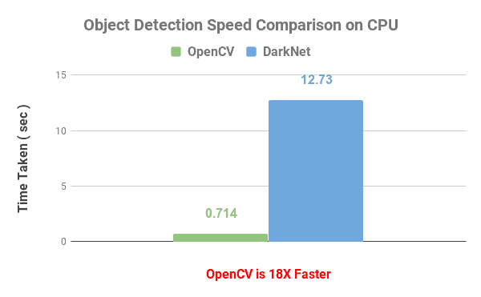
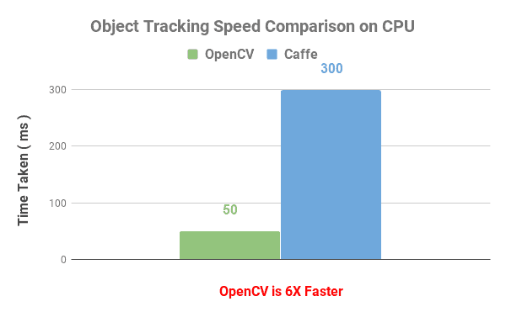
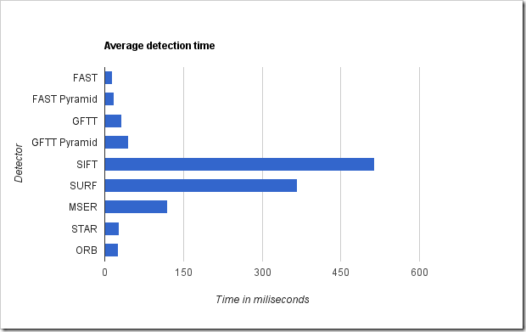
Some comparison graphs

Slide 69
OpenCV features
OpenCV offers a wide range of features, including:
Image processing: OpenCV includes a variety of image processing functions, such as filtering, transformations, and color space conversions.
Feature detection and description: OpenCV can detect and describe features in images, such as corners, edges, and blobs. This information can be used for object recognition, tracking, and matching.
Object detection and tracking: OpenCV includes modules for detecting and tracking specific objects in images and videos, such as faces, eyes, cars, and pedestrians.
Machine learning: OpenCV includes modules for training and deploying machine learning models for computer vision tasks.

Slide 70
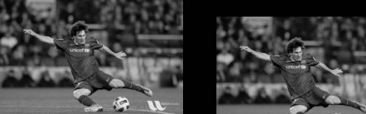
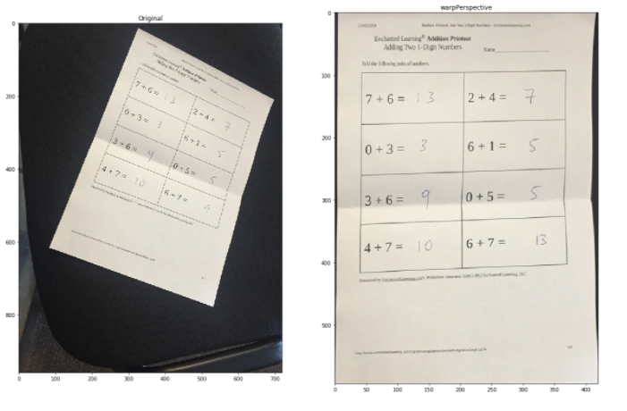
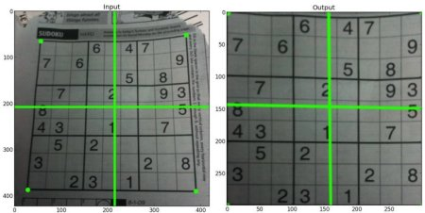
Image Processing using OpenCV
Here are some example images of perspective conversion, transformations, thresholding, and operations in OpenCV:
Scaling: Scaling is just resizing of the image. OpenCV comes with a function cv.resize() for this purpose. The size of the image can be specified manually, or you can specify the scaling factor.
Perspective Transformation: For getting better information about an image, we can change the perspective of a video or an image. In OpenCV, we use two functions for Perspective transformation getPerspectiveTransform() and then warpPerspective().

Slide 71
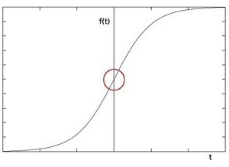
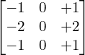
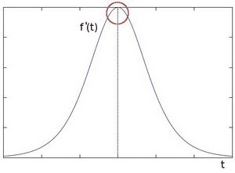
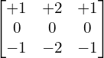
Edge Detection using OpenCV
Sobel edge detection: Sobel Edge Detection is one of the most widely used algorithms for edge detection. The Sobel Operator detects edges marked by sudden changes in pixel intensity, as shown in the figure below. The rise in intensity is even more evident when we plot the first derivative of the intensity function.
These are the kernels used for Sobel Edge Detection:
X-Direction Kernel
Y-Direction Kernel
Pixel intensity function
First Derivative of Pixel intensity function
Some info about haar matrices(filters)

Slide 72
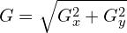
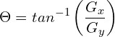
Edge Detection using OpenCV
Canny edge detection: Canny Edge Detection is one of the most popular edge-detection methods in use today because it is so robust and flexible. The algorithm itself follows a three-stage process for extracting edges from an image. Add to it image blurring, a necessary preprocessing step to reduce noise. This makes it a four-stage process, which includes:
Noise Reduction
Calculating the Intensity Gradient of the Image
Suppression of False Edges
Hysteresis Thresholding
Noise Reduction: In Canny Edge Detection, a Gaussian blur filter is used to essentially remove or minimize unnecessary detail that could lead to undesirable edges.
Calculating the Intensity Gradient of the Image: Once the image has been smoothed (blurred), it is filtered with a Sobel kernel, both horizontally and vertically. The results from these filtering operations are then used to calculate both the intensity gradient magnitude (G), and the direction (ϴ) for each pixel, as shown below.
The gradient direction is then rounded to the nearest 45-degree angle. The figure below (right) shows the result of this combined processing step.

Slide 73
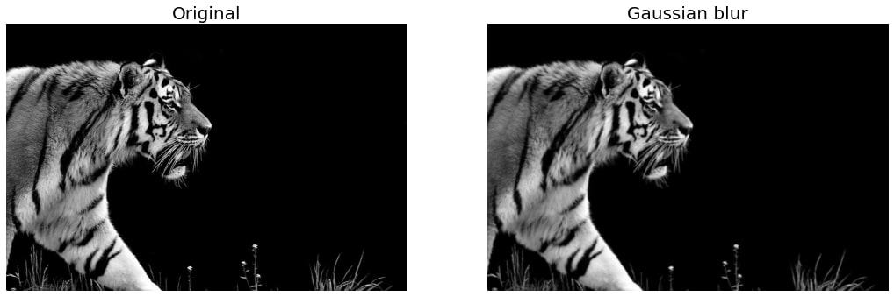
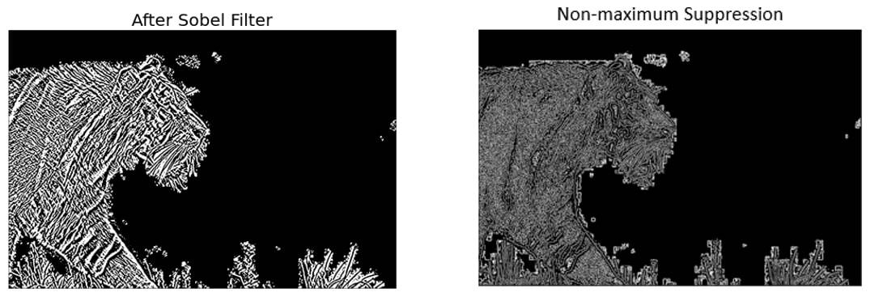
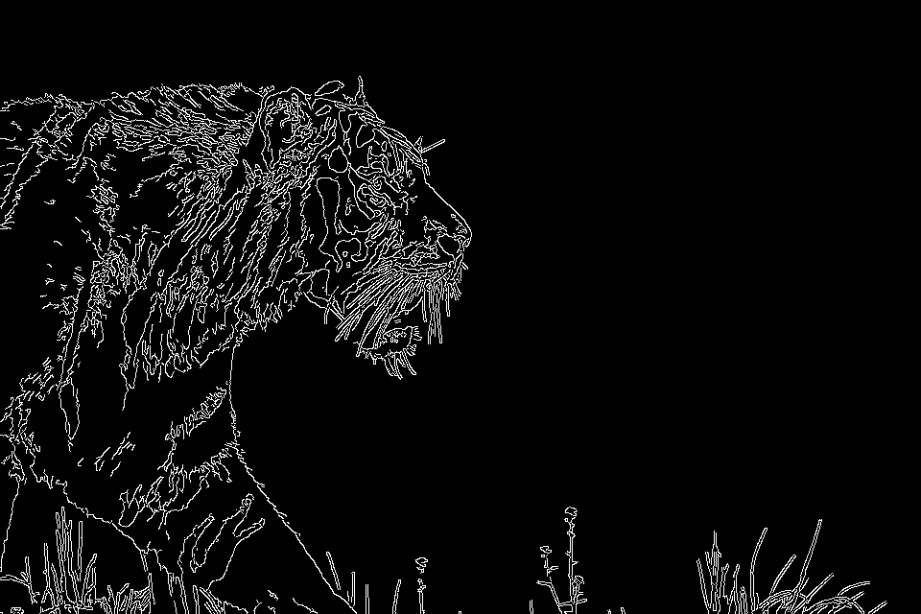
Contd.
Suppression of False Edges: Each pixel is compared to its neighboring pixels in the positive and negative gradient direction. If the gradient magnitude of the current pixel is greater than its neighboring pixels, it is left unchanged. Otherwise, the magnitude of the current pixel is set to zero.
Hysteresis thresholding: It uses two thresholds, a high one and a low one, to classify pixels as either edges or non-edges.To classify a pixel as an edge, rules are:
If the pixel's gradient magnitude is above the high threshold, then the pixel is classified as an edge.
If the pixel's gradient magnitude is below the low threshold, then the pixel is classified as a non-edge.
If the pixel's gradient magnitude is between the high and low thresholds, then the pixel is classified as an edge if it is connected to a pixel that is already classified as an edge.
Demo Colab Notebook : link
Final Image

Slide 74
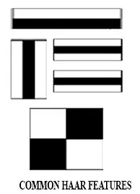
Object Detection using OpenCV
Haar Cascade Classifiers: Haar cascades are based on the Haar wavelet transform and are a type of machine learning algorithm used for object detection. They work by scanning an image or video frame at different scales and looking for regions of interest that match predefined patterns of features. These patterns are learned from a training set of positive and negative examples. Haar cascades are computationally efficient and can work in real-time on low-power devices.
Positive images: Those images which contain object of interest.
Negative images: Those images which contain everything other than object of interest.
Working of the classifiers:
Just like our convolutional kernel, each feature is a single value obtained by subtracting sum of pixels under the white rectangle from sum of pixels under the black rectangle.
Now, all possible sizes and locations of each kernel are used to calculate lots of features.(Just imagine how much computation it needs? Even a 24x24 window results over 160000 features).To solve this, integral image is introduced.However large your image, it reduces the calculations for a given pixel to an operation involving just four pixels. Nice, isn't it? It makes things super-fast.(contd.)

Slide 75
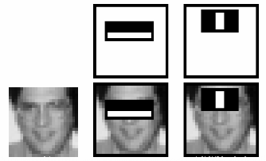
Contd.
But among all these features we calculated, most of them are irrelevant. Consider the image, the top row shows two good features. The first feature selected seems to focus on the property that the region of the eyes is often darker than the region of the nose and cheeks. The second feature selected relies on the property that the eyes are darker than the bridge of the nose. But the same windows applied to cheeks or any other place is irrelevant. So how do we select the best features? This is done using Adaboost.
For this, we apply each and every feature on all the training images. We classify the images to positive and negative. Obviously, there will be errors or misclassifications. We select the features with minimum error rate.
This process is repeated and it gives some weak classifiers. The final classifier is a weighted sum of these weak classifiers. It is called weak because it alone can't classify the image, but together with others forms a strong classifier.
So now you take an image. Take each 24x24 window. Apply 6000 features to it. Check if it is the object or not.
Isn't it a little inefficient and time consuming? So a better idea is to divide these features into stages and pass the images through stages. If it is rejected at any stage, it is not the object of interest. And, if it passes all it is an object of interest.

Slide 76
Check this https://huggingface.co/docs/transformers/model_doc/detr

Slide 77
QnA
What is Single Stage vs Two(multi stage detectors)?
OpenCV based object detection Notebook is missing

Slide 78
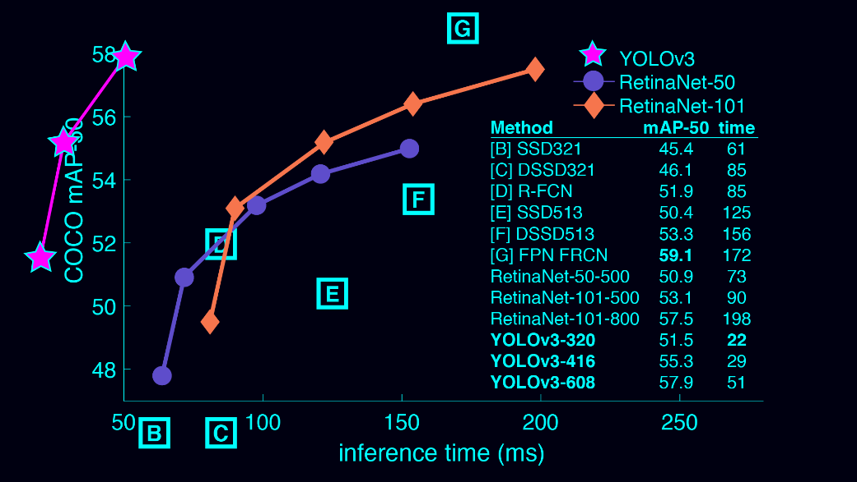
Yolo (You Look Only Once)
You only look once (YOLO) is a state-of-the-art, real-time object detection system

Slide 79
Object detection algorithms are broadly classified into two categories based on how many times the same input image is passed through a network.
Single-shot object detection
Single-shot object detection uses a single pass of the input image to make predictions about the presence and location of objects in the image. It processes an entire image in a single pass, making them computationally efficient.
However, single-shot object detection is generally less accurate than other methods, and it’s less effective in detecting small objects. Such algorithms can be used to detect objects in real time in resource-constrained environments.
YOLO is a single-shot detector that uses a fully convolutional neural network (CNN) to process an image. We will dive deeper into the YOLO model in the next section.

Slide 80
Two-shot object detection
Two-shot object detection uses two passes of the input image to make predictions about the presence and location of objects. The first pass is used to generate a set of proposals or potential object locations, and the second pass is used to refine these proposals and make final predictions. This approach is more accurate than single-shot object detection but is also more computationally expensive.
Overall, the choice between single-shot and two-shot object detection depends on the specific requirements and constraints of the application.
Generally, single-shot object detection is better suited for real-time applications, while two-shot object detection is better for applications where accuracy is more important.

Slide 81
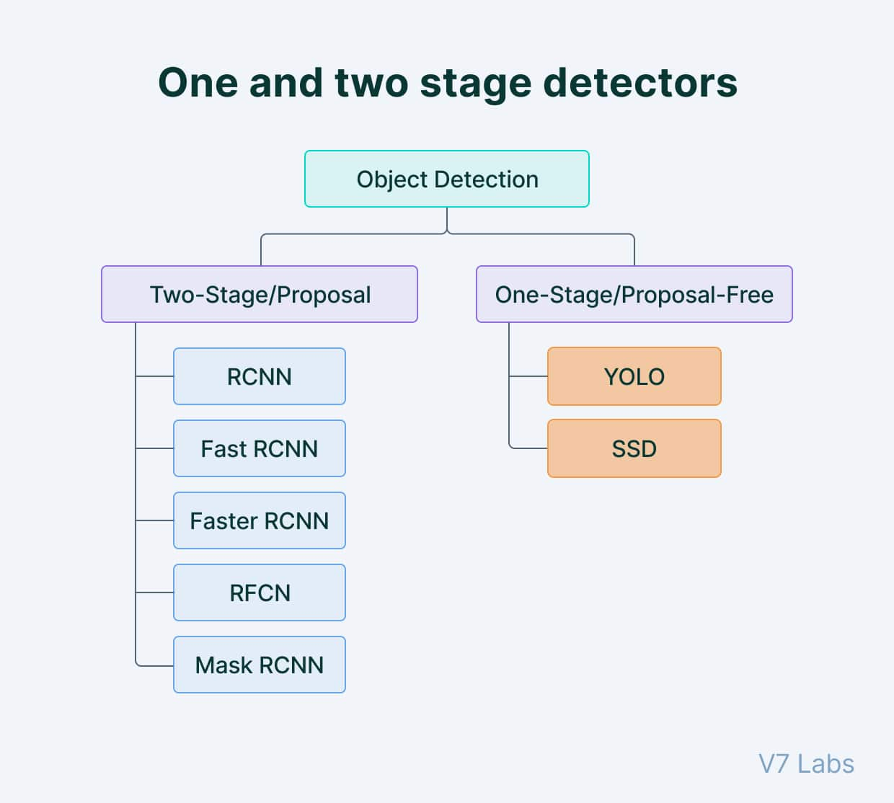

Slide 82


Slide 83
YOLO (You Only Look Once) is a single-shot object detection algorithm. This means that it can detect objects in an image in a single pass, without the need for any region proposal or refinement steps. This makes YOLO very fast and efficient, making it well-suited for real-time applications.
YOLO first divides the input image into a grid of cells. For each cell, YOLO predicts a set of bounding boxes, each with a confidence score. The confidence score indicates how likely it is that the bounding box contains an object. YOLO also predicts a class probability for each bounding box, which indicates the likelihood that the bounding box contains a particular object class.

Slide 84
Traditionally, object detection algorithms have used a two-stage approach. In the first stage, the algorithm proposes a set of regions of interest (ROIs) that may contain objects. In the second stage, the algorithm classifies the ROIs and refines the bounding boxes.
YOLO differs from this two-stage approach in several ways:
YOLO predicts bounding boxes directly from the input image, without the need for any region proposal step. This makes YOLO much faster than traditional object detection algorithms.
YOLO predicts multiple bounding boxes for each cell in the grid. This allows YOLO to handle objects of different sizes and shapes more effectively.
YOLO predicts class probabilities for each bounding box. This allows YOLO to classify objects more accurately than traditional object detection algorithms.

Slide 85

The architecture of the CNN model that forms the backbone of YOLO is shown below.

Slide 86
How Yolo Works?
The first 20 convolution layers of the model are pre-trained using ImageNet by plugging in a temporary average pooling and fully connected layer. Then, this pre-trained model is converted to perform detection since previous research showcased that adding convolution and connected layers to a pre-trained network improves performance. YOLO’s final fully connected layer predicts both class probabilities and bounding box coordinates.
YOLO divides an input image into an S × S grid. If the center of an object falls into a grid cell, that grid cell is responsible for detecting that object. Each grid cell predicts B bounding boxes and confidence scores for those boxes. These confidence scores reflect how confident the model is that the box contains an object and how accurate it thinks the predicted box is.

Slide 87
YOLO predicts multiple bounding boxes per grid cell. At training time, we only want one bounding box predictor to be responsible for each object. YOLO assigns one predictor to be “responsible” for predicting an object based on which prediction has the highest current IOU with the ground truth. This leads to specialization between the bounding box predictors. Each predictor gets better at forecasting certain sizes, aspect ratios, or classes of objects, improving the overall recall score.
One key technique used in the YOLO models is non-maximum suppression (NMS). NMS is a post-processing step that is used to improve the accuracy and efficiency of object detection. In object detection, it is common for multiple bounding boxes to be generated for a single object in an image. These bounding boxes may overlap or be located at different positions, but they all represent the same object. NMS is used to identify and remove redundant or incorrect bounding boxes and to output a single bounding box for each object in the image.

Slide 88

Yolov8

Slide 89


Slide 90

Metrics used in yolov8

Slide 91
Loss Function in Yolo
Bounding Box Loss:
Bounding Box Loss measures the error between the predicted bounding box's geometry (coordinates) and the ground truth bounding box's geometry. YOLOv8 predicts the coordinates of the bounding boxes for detected objects. The loss function used for bounding box regression typically includes components for both the box's location (center coordinates) and size (width and height).
Location Loss: This part of the loss measures how well the model predicts the center (x, y) coordinates of the bounding box. It is often calculated using metrics like mean squared error (MSE) or smooth L1 loss.
Size Loss: This part of the loss evaluates the accuracy of the model's predictions for the width and height of the bounding box. Like the location loss, it is usually calculated using MSE or smooth L1 loss.

Slide 92
Objectness Loss:
Objectness Loss in YOLOv8 determines how confident the model is about the presence of an object in a specific bounding box. It quantifies how well the model distinguishes between areas containing objects and those that don't. YOLOv8 uses a logistic regression model to predict the probability of an object being present inside a bounding box.
Confidence Loss: This part of the objectness loss compares the predicted objectness score (probability of an object being present) with the ground truth value. Typically, binary cross-entropy loss is used for this comparison. If there is an object in the ground truth box, the predicted probability should be close to 1, and if there's no object, it should be close to 0.

Slide 93
Segmentation Loss:
While YOLOv8 primarily focuses on object detection, it can also incorporate semantic segmentation loss when dealing with tasks that require pixel-wise object labeling, such as instance segmentation.
Segmentation Loss: This loss quantifies how well the predicted segmentation map aligns with the ground truth map. It measures the similarity between the pixel-wise class predictions made by the model and the true class labels for each pixel in the image. Commonly used loss functions for this purpose include cross-entropy loss for pixel-wise classification.

Slide 94
It's worth noting that YOLOv8 may use a combination of these loss components in its total loss function, and the specific formulations and hyperparameters can vary depending on the model's architecture and the dataset being used. The overall goal of these loss components is to guide the model during training to accurately predict object bounding boxes, objectness scores, and, if applicable, segmentation maps for the objects present in the input image
If youre interested to know more about the loss functions , read this article:
https://arxiv.org/pdf/2305.09972.pdf

Slide 95

RT-DETR: The Next Generation of Object Detection
RT-DETR (Real-Time DEtection TRansformer) is a state-of-the-art object detection model that leverages the power of Vision Transformers (ViTs) to achieve real-time performance while maintaining high accuracy. It is the first real-time end-to-end object detector to outperform YOLO detectors on both speed and accuracy.

Slide 96
RT-DETR: Architecture Explained
Efficient Hybrid Encoder: The efficient hybrid encoder is responsible for extracting multiscale features from the input image. It consists of two modules: an intra-scale feature interaction (AIFI) module and a cross-scale feature-fusion module (CCFM). The AIFI module models intra-scale dependencies in the multiscale features, while the CCFM module fuses multiscale features from different scales.
IoU-aware Query Selection: The IoU-aware query selection module selects a fixed number of image features to serve as initial object queries for the decoder. It takes into account the similarity between image features and object bounding boxes to select informative queries.
Decoder with Auxiliary Prediction Heads: The decoder is responsible for refining the initial object queries and generating the final object detections. It consists of a stack of transformer layers. The auxiliary prediction heads are used to provide intermediate supervision during training, which helps to improve the model's accuracy.

Slide 97
RT-DETR: How it Works?
Step 1: Efficient Hybrid Encoder
The efficient hybrid encoder processes the input image to extract multiscale features. Multiscale features are features that are extracted from the image at different scales. This allows the model to capture both fine-grained and coarse-grained information about the objects in the image.
The efficient hybrid encoder consists of two modules: an intra-scale feature interaction (AIFI) module and a cross-scale feature fusion (CCFM) module.
Intra-scale Feature Interaction (AIFI) Module
The AIFI module models intra-scale dependencies in the multiscale features. It does this by using a series of self-attention layers. Each self-attention layer allows the network to learn how to attend to different parts of the multiscale features in order to extract more informative features.
Cross-scale Feature Fusion (CCFM) Module
The CCFM module fuses multiscale features from different scales in a lightweight and efficient manner. It does this by using a series of residual blocks. Each residual block learns to combine features from different scales in order to extract more informative features.

Slide 98
RT-DETR: How it Works?
Step 2: IoU-aware Query Selection
The IoU-aware query selection module selects a fixed number of image features to serve as initial object queries for the decoder. It does this by taking into account the similarity between image features and object bounding boxes.
Specifically, the IoU-aware query selection module uses a cosine similarity function to measure the similarity between each image feature and each object bounding box. The image features with the highest similarity scores are then selected as the initial object queries for the decoder.
Step 3: Decoder
The decoder is responsible for refining the initial object queries and generating the final object detections. It consists of a stack of transformer layers.
Each transformer layer in the decoder learns to refine the object queries by attending to the multiscale features extracted by the efficient hybrid encoder. The decoder also includes a series of auxiliary prediction heads, which are used to provide intermediate supervision during training. This helps to improve the model's accuracy.

Slide 99
RT-DETR: How it Works?
Step 4: Auxiliary Prediction Heads
The auxiliary prediction heads are used to provide intermediate supervision during training. They are trained to predict the object bounding boxes and confidence scores for the initial object queries. This helps the model to learn to generate more accurate object detections.
Once the decoder has refined the object queries, it generates the final object detections by predicting the object bounding boxes and confidence scores. The object bounding boxes are then used to locate the objects in the image, and the confidence scores are used to indicate how likely it is that the object bounding boxes contain real objects.
Conclusion
RT-DETR is a powerful and versatile object detection model that can be used in a variety of applications. It achieves real-time performance while maintaining high accuracy. This is due to its efficient hybrid encoder architecture and its IoU-aware query selection module.

Slide 100
Some Technical Jargons Explained
MultiScale Features:
Multiscale features are features that are extracted from an image at different scales. This allows the model to capture both fine-grained and coarse-grained information about the objects in the image.
For example, a low-scale feature might capture the overall shape of an object, while a high-scale feature might capture the fine details of the object's surface. By combining multiscale features, the model can get a more complete understanding of the objects in the image.
Multiscale features are used in a variety of computer vision tasks, including object detection, image segmentation, and scene understanding. They are also used in other machine learning tasks, such as natural language processing and speech recognition.
Some examples of multiscale features:
Image pyramids
Scale-invariant feature transform (SIFT) descriptors
Histogram of oriented gradients (HOG) features

Slide 101
Some Technical Jargons Explained
Self-Attention Layers:
Self-attention layers have been used to achieve state-of-the-art results on a variety of computer vision tasks, including image classification, object detection, and image segmentation.
In computer vision, self-attention layers are typically used to learn spatial relationships between different parts of an image. This is done by comparing each pixel in the image to every other pixel. The self-attention layer then learns to weigh the importance of each pixel in order to extract more informative features.
Self-attention layers have a number of advantages over traditional convolutional neural networks (CNNs) for computer vision tasks.
Self-attention layers are able to model long-range dependencies in the image, which is important for tasks such as object detection and image segmentation.
Self-attention layers are able to learn to attend to different parts of the image in parallel, which makes them much faster than CNNs.

Slide 102
Some Technical Jargons Explained
Object Queries
Object queries are a set of learned positional embeddings that are used by attention modules in decoder layers to decode the object classes or bounding boxes using the region of interests in an image. They were first introduced in the DETR (Detection Transformer) model, which was the first transformer-based object detector to achieve state-of-the-art results.
Object queries are typically initialized randomly and then learned during training. The decoder learns to attend to the different object queries in order to decode the object classes or bounding boxes.
The input image is passed through an encoder to extract features. The object queries are then fed into the decoder along with the encoded features. The decoder learns to attend to the different object queries in order to decode the object classes or bounding boxes.
Object queries have a number of advantages over traditional object detection methods.
Object queries are able to learn long-range dependencies in the image, which is important for tasks such as object detection and image segmentation.
Object queries are able to learn to attend to different parts of the image in parallel, which makes them much faster than traditional object detection methods.

Slide 103
Some Technical Jargons Explained
Auxiliary Prediction Heads
Auxiliary prediction heads are neural network modules that are used to provide intermediate supervision during training. They are typically used in tasks such as object detection and image segmentation, where the output of the model is a complex structure, such as a bounding box or a segmentation mask.
Auxiliary prediction heads are trained to predict a subset of the output of the model, such as the object class or the bounding box coordinates. This provides the model with intermediate feedback during training, which can help it to learn more effectively.
Auxiliary prediction heads have a number of advantages.
These can help to improve the accuracy of the model. This is because they provide the model with intermediate feedback during training, which can help it to learn more effectively.
Auxiliary prediction heads can help to speed up training. This is because they allow the model to learn more quickly by providing it with intermediate feedback.

Slide 104

Comparison of RT-DETR and other models

Slide 105
Loss Functions of RT-DETR
Classification Loss
The classification loss is used to train the model to predict the object class for each initial object query. The classification loss is typically implemented using cross-entropy loss.
Bounding Box Regression Loss
The bounding box regression loss is used to train the model to predict the bounding box coordinates for each initial object query. The bounding box regression loss is typically implemented using smooth L1 loss.
In addition to the classification loss and bounding box regression loss, the RT-DETR model also uses a number of auxiliary prediction heads to provide intermediate supervision during training. The auxiliary prediction heads are also trained using classification loss and bounding box regression loss.
The loss functions are weighted and combined to form the total loss of the model. The total loss is then minimized during training using an optimizer such as AdamW which uses a modified weight decay scheme that helps to prevent the model from overfitting to the training data.

Slide 106
Performance Metrics of RT-DETR
AP50 and AP75
AP50 and AP75 are metrics used to evaluate the performance of object detection models. AP stands for Average Precision.
AP50 is the Average Precision calculated at an Intersection over Union (IoU) threshold of 50%. IoU is a measure of how much overlap there is between a predicted bounding box and a ground truth bounding box.
AP75 is the Average Precision calculated at an IoU threshold of 75%.
AP50 and AP75 are important metrics for object detection because they measure the model's ability to detect objects accurately and localize them precisely.
The IoU threshold is used to determine whether a prediction is considered a true positive or a false positive. A prediction is considered a true positive if the IoU between the predicted bounding box and the ground truth bounding box is greater than or equal to the IoU threshold. Otherwise, the prediction is considered a false positive.
A higher AP50 and AP75 score indicates that the model is better at detecting objects accurately and localizing them precisely.

Slide 107
Performance Metrics of RT-DETR
APS, APM & APL
APS stands for Average Precision at Small object scale. It is calculated in the same way as AP50, but only for objects with an area smaller than 32^2 pixels. APS is an important metric for object detection in autonomous driving and pedestrian detection because it measures the model's ability to detect small objects, such as pedestrians, cyclists, and traffic signs.
APL stands for Average Precision at Large object scale. It is calculated in the same way as AP50, but only for objects with an area greater than 96^2 pixels. APL is an important metric for object detection in video surveillance and autonomous driving because it measures the model's ability to detect large objects, such as trucks, buses, and buildings.
APM stands for Average Precision at Medium object scale. It is calculated in the same way as AP50, but only for objects with an area between 32^2 and 96^2 pixels. APM is an important metric for object detection in video surveillance and autonomous driving because it measures the model's ability to detect medium-sized objects, such as people, cars, and bicycles.
These are typically used in conjunction with AP50 to provide a more comprehensive assessment of the performance of an object detection model.

Slide 108
How is RT-DETR better than other?
RT-DETR is a state-of-the-art object detection model that offers a number of advantages over other models, including:
Accuracy: RT-DETR achieves state-of-the-art accuracy on a variety of object detection benchmarks, including COCO and Cityscapes.
Speed: RT-DETR is faster than many other object detection models, including YOLOv5 and Faster R-CNN.
End-to-end training: RT-DETR can be trained end-to-end, without the need for hand-crafted heuristics such as non-maximum suppression (NMS).
Versatility: RT-DETR can be used for a variety of tasks, including object detection, instance segmentation, and keypoint detection.
Model | Accuracy (AP50) | Speed (FPS) | End-to-end training | Versatility
RT-DETR | 53.7% | 50 | Yes | Object detection, instance segmentation, keypoint detection
YOLOv5 | 52.0% | 35 | No | Object detection
Faster R-CNN | 51.3% | 20 | No | Object detection

Slide 109
Further Trends in Object Detection
https://www.einfochips.com/blog/understanding-object-localization-with-deep-learning/

Slide 110
References and Further reads
https://dudeperf3ct.github.io/object/detection/2019/01/07/Mystery-of-Object-Detection/#introduction-to-object-detection

